Slide 1

MEMORY AND I/O
Module -III

Slide 2
MEMORY AND I/O
Cache Memory - Computer Memory System Overview - Cache Memory Principles - Elements of Cache Design - Internal Memory - External Memory - Input/Output - External Devices - I/O Modules - Programmed I/O - InterruptDriven I/O - Direct Memory Access.

Slide 3
Cache memory
Cache memory is a specialized, high-speed memory component designed to store frequently accessed data from main memory. It operates as a smaller, faster intermediary between the CPU and main memory, holding copies of frequently used instructions and data.
Within a CPU, there exist multiple independent caches dedicated to storing different types of instructions and data. The primary function of cache memory is to decrease the average access time to data stored in main memory, thereby enhancing overall system performance.

Slide 4
Characteristics of cache memory
Cache memory serves as a rapid intermediary between the CPU and RAM, functioning as a buffer. It stores frequently accessed data and instructions, ensuring swift access for the CPU.
Although more expensive than RAM or disk memory, cache memory is more cost-effective than CPU registers.
Cache memory enhances and synchronizes with high-speed CPUs, accelerating overall system performance.

Slide 5
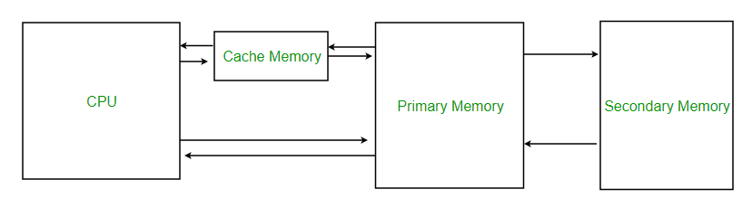
Cache memory

Slide 6
Levels of Memory
Level 1 or Register: It is a type of memory in which data is stored and accepted that are immediately stored in the CPU. The most commonly used register is Accumulator, Program counter, Address Register, etc.
Level 2 or Cache memory: It is the fastest memory that has faster access time where data is temporarily stored for faster access.

Slide 7
Levels of Memory
Level 3 or Main Memory: It is the memory on which the computer works currently. It is small in size and once power is off data no longer stays in this memory.
Level 4 or Secondary Memory: It is external memory that is not as fast as the main memory but data stays permanently in this memory.

Slide 8
Cache Performance
When the processor needs to read or write a location in the main memory, it first checks for a corresponding entry in the cache.
If the processor finds that the memory location is in the cache, a Cache Hit has occurred and data is read from the cache.
If the processor does not find the memory location in the cache, a cache miss has occurred. For a cache miss, the cache allocates a new entry and copies in data from the main memory, then the request is fulfilled from the contents of the cache.

Slide 9
Cache Performance
The performance of cache memory is frequently measured in terms of a quantity called Hit ratio..
Hit Ratio(H) = hit / (hit + miss) = no. of hits/total accesses Miss Ratio = miss / (hit + miss) = no. of miss/total accesses = 1 - hit ratio(H)
We can improve Cache performance using higher cache block size, and higher associativity, reduce miss rate, reduce miss penalty, and reduce the time to hit in the cache.

Slide 10
Cache Principle
The purpose of cache memory is to offer the swiftest access to resources while balancing considerations of size and cost.
When the processor seeks to retrieve a byte of data, it initially checks the cache memory. If the byte isn't found in the cache, the processor then searches for it in the main memory.

Slide 11
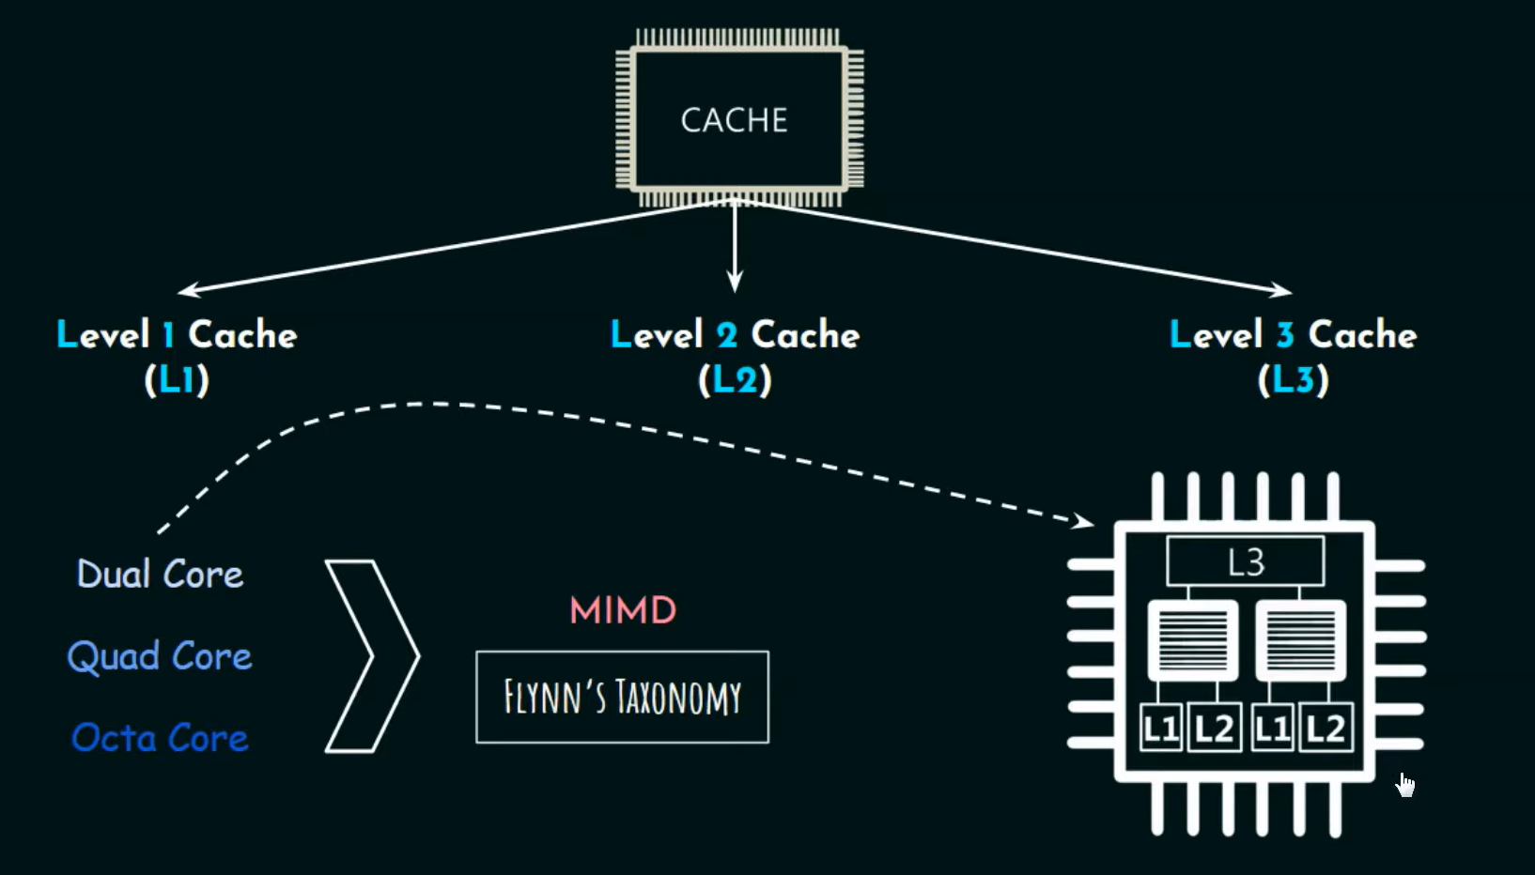
Three Level Cache

Slide 12
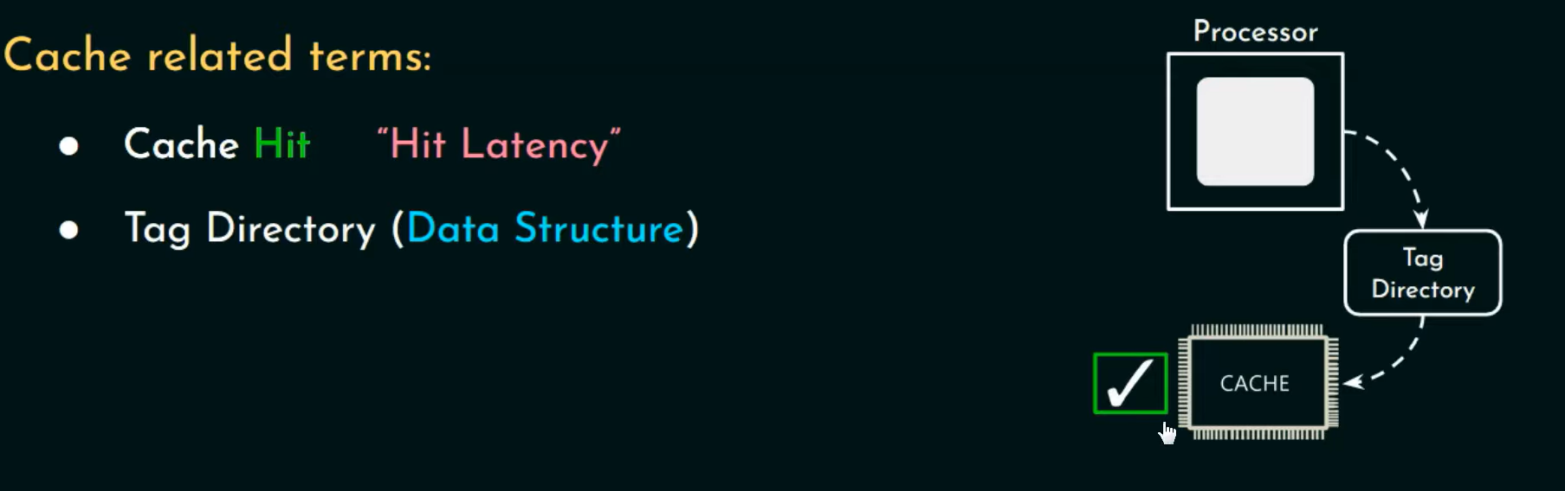
Cache hit

Slide 13
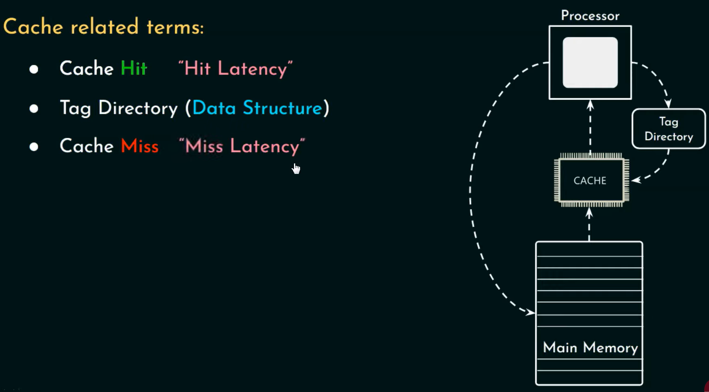
Cache miss

Slide 14
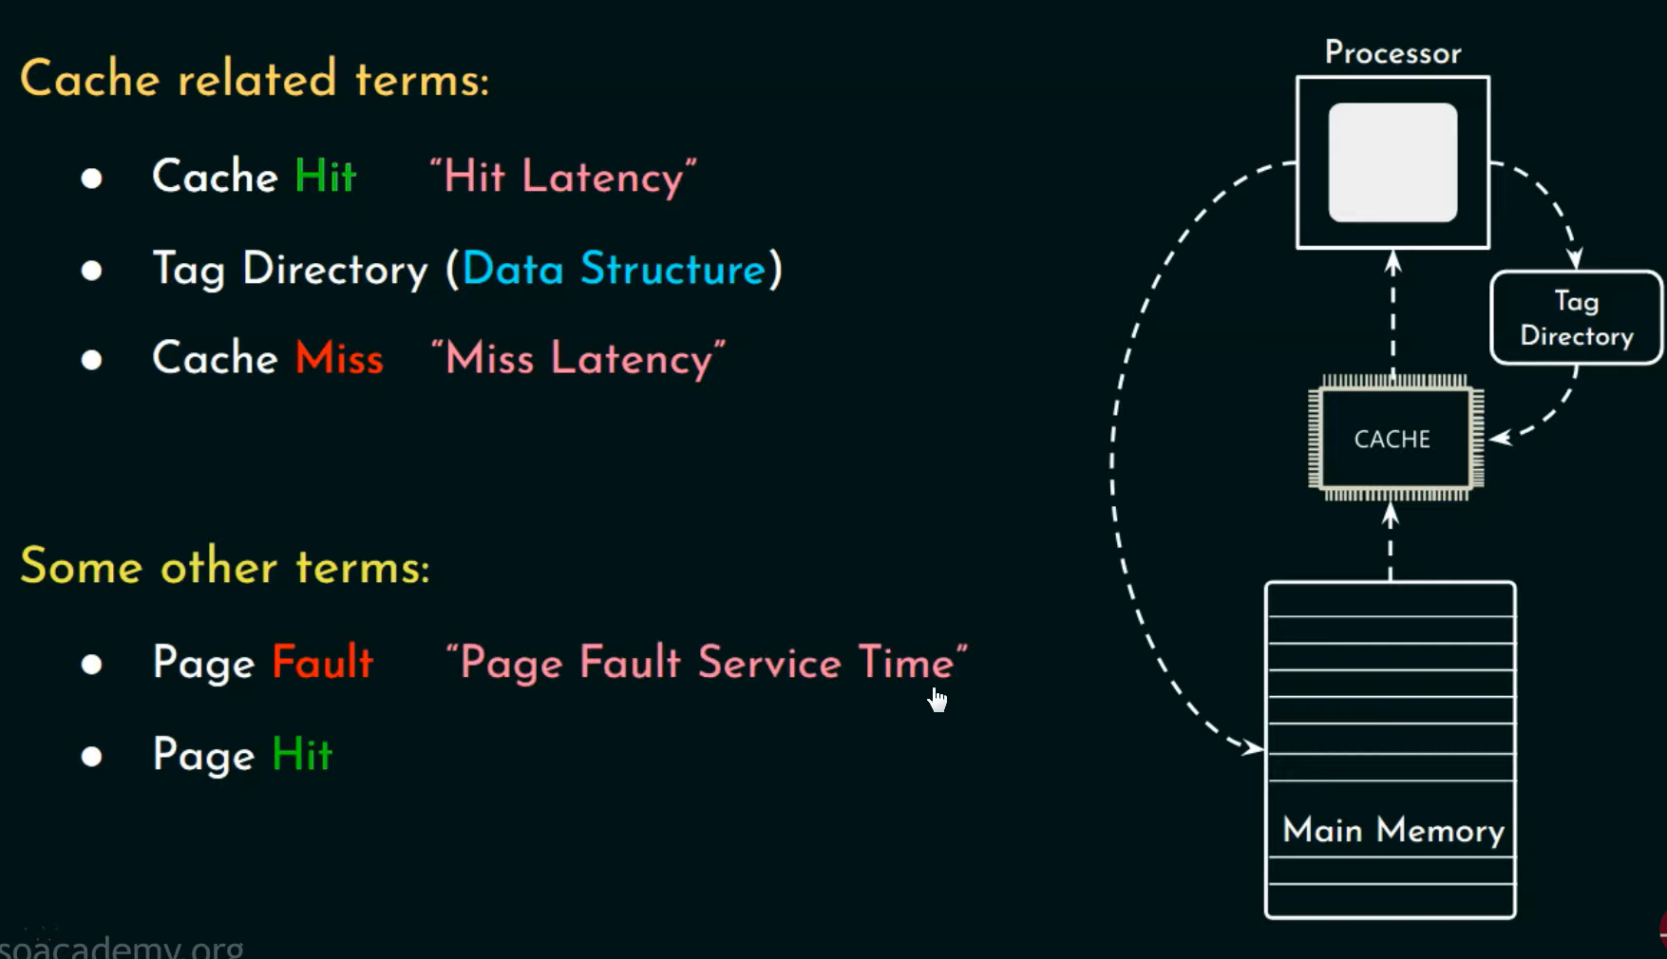
Page fault

Slide 15
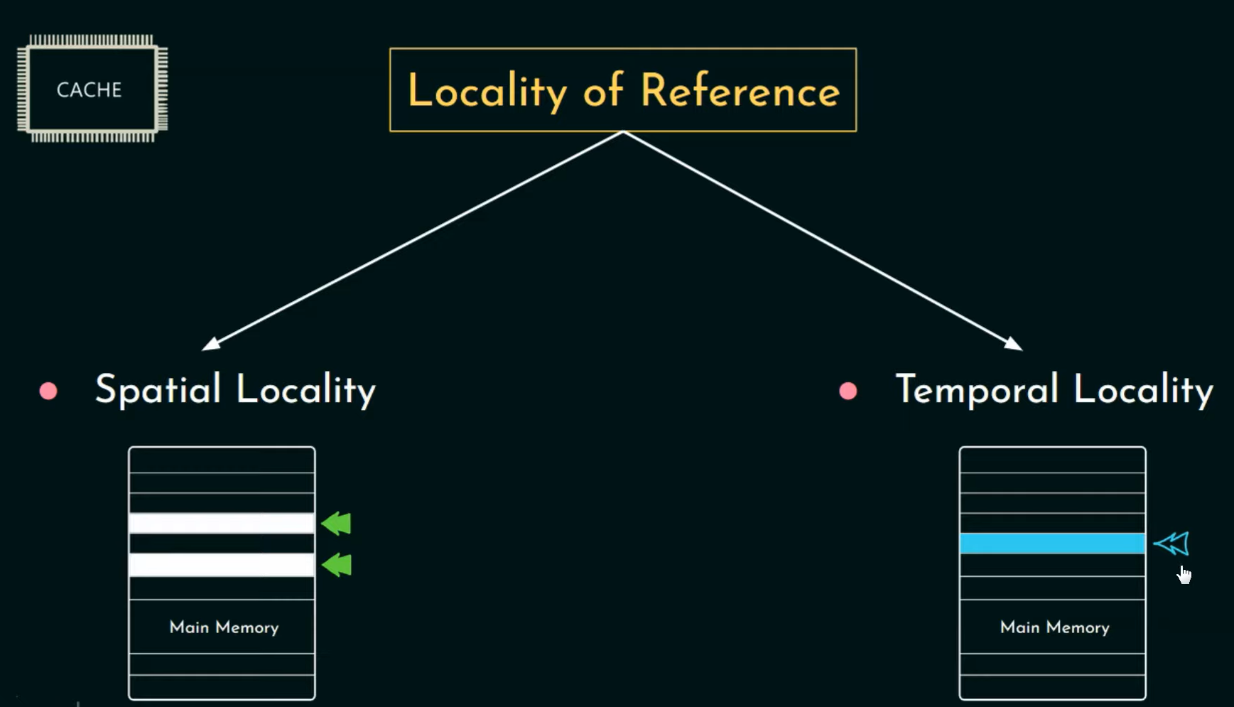
Locality of reference

Slide 16
Principle of Locality
After locating the byte in the main memory, a block containing a fixed number of bytes is fetched into the cache memory and subsequently accessed by the processor. This action enhances the likelihood of finding subsequent bytes in the cache memory. This increased probability is due to the phenomenon known as Locality of Reference or Principle of Locality, where relevant bytes are more likely to be found together in memory as they are frequently accessed by the same process.

Slide 17
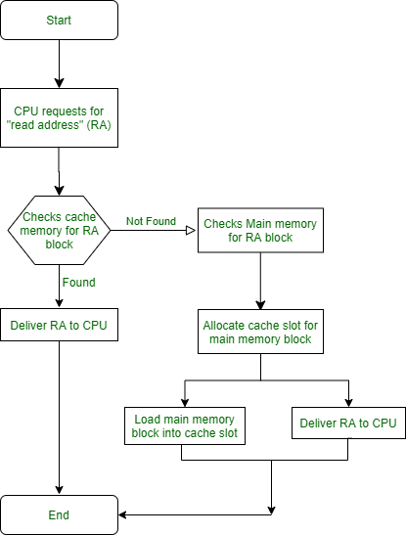
Cache Memory Design

Slide 18
Cache Memory Design
Cache Size and Block Size To synchronize with the processor speed, cache memories are kept small to minimize the time required for data retrieval. They are often organized into multiple layers based on the system architecture. The size of the cache should be sufficient to accommodate the block size, which is determined by the processor's architecture.
Increasing the block size initially boosts the hit ratio due to the Principle of Locality, as more relevant data is brought into the cache. However, further increases in block size can lead to a decrease in hit ratio. This is because beyond a certain point, the likelihood of utilizing the newly introduced data diminishes compared to reusing the data being replaced to make space for newer blocks.

Slide 19
Mapping function
When data is fetched from main memory, a mapping function decides where it goes in the cache. If the cache is full, a block must be replaced. The challenge is choosing which block to replace without replacing one that the processor is likely to need soon. The replacement algorithm depends on the mapping function. A more flexible mapping function can improve hit ratio, but it also increases the complexity of the circuitry needed to search the cache to determine if a block is already present.

Slide 20
Replacement algorithm
When the cache is full and a new block from main memory needs to replace one in the cache, the Least Recently Used (LRU) algorithm is applied. This algorithm selects the block that hasn't been accessed for the longest time, assuming it's less likely to be needed soon. This way, it prioritizes keeping recently used data in the cache while minimizing the likelihood of evicting frequently accessed blocks.

Slide 21
Write policy
One crucial aspect of memory caching is determining when to write back the cache block to main memory to prevent data loss. Two options are available:
Write Back When Chosen for Replacement: This option writes the cache block back to main memory only when it's replaced by a new block from main memory. This minimizes excessive write operations on main memory but may delay updating changes made to the block.
Write Back After Every Update: This option writes the cache block back to main memory after every update. While ensuring changes are promptly reflected in main memory, it may lead to excessive writes and potential inefficiencies, especially in a multi-processor system where the main memory block may become obsolete before being replaced from cache.

Slide 22
What is I/O (input/output)?
I/O (input/output), pronounced "eye-oh," describes any operation, program or device that transfers data to or from a computer. Common I/O devices include printers, hard disks, keyboards and mice.
Input/output devices play a crucial role in computer programming by streamlining how computing devices communicate across a network.

Slide 23
Why is I/O important?
In computer architecture, I/O encompasses a range of tasks that must be executed properly to support sharing data among discrete machines. All types of data movement within a system rely on I/O operations, including audio files, software instruction sets, text and video streams.
Input/output signals carry instructions that a computer's central processing unit (CPU) must execute to initiate data transfer. The input can come from hardware, software or human interaction.
I/O input signals shuttle data from a CPU, storage controller or memory to a storage device. I/O output signals flow from a computer to an output device.

Slide 24
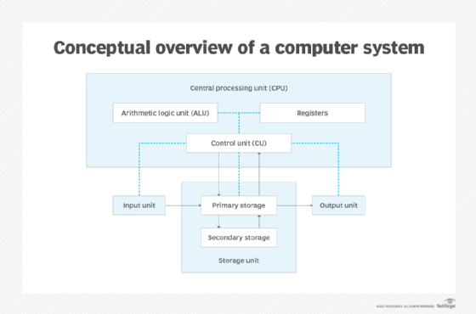

Slide 25
How do I/O operations occur?
I/O devices are categorized generally as storage, network communications, user interface or related hardware services that use discrete systems to interface with a computer. To communicate, devices use parallel or serial I/O ports, or an over-the-air signal.
Input/output falls into two categories: hard I/O and soft I/O. Hard I/O refers to a straightforward transfer of data that occurs between a computer and an external physical device, such as a keyboard or a mouse. Soft I/O occurs when data is transferred between computers or servers over a network, such as streaming media or file sharing.

Slide 26
What is I/O memory management?
Modern computing systems are often built with an I/O processor situated between the system bus and attached peripherals. I/O processors are specifically equipped to handle the operations associated with data transfer.
To facilitate communication between I/O devices and processors, an I/O interface identifies all addresses generated by the CPU. Controllers are tasked with making sure data is transmitted to the computer's assortment of components.

Slide 27
What is I/O memory management?
Programmed I/O (PIO). This method requires the processor to execute commands for every I/O transfer; thus, it is the slowest method. The advantage is that programmed I/O is the simplest to program.
Interrupt-driven I/O. With this method, an I/O device sends a command when it is ready to receive data. The CPU then suspends what it is doing temporarily to carry out the new instructions before resuming its prior activities. In this way, the CPU does not need to check the receiving status of the I/O device.
Advanced Programmable Interrupt Controller (APIC). This variation sends an interrupt signal to the APIC to notify the processor when a device is prepared to send data.

Slide 28
What is I/O memory management?
Direct memory access (DMA). DMA bypasses the CPU to send data commands from peripherals to main memory. DMA is the replacement for PIO, also known as programmable I/O, a process in which the CPU manages all data transactions.
Input-output memory machine unit (IOMMU). Designed for virtual machines, IOMMU allows an operating system (OS) to correlate the mapping of physical and virtual devices to efficiently allocate memory resources.

